Slide 1
CS-725 Project: Predict future sales
Abhinandan Singh (203050031)
Ajay Sarup Jain (203050036)
Ankush Agrawal (203050007)
Deepak Singh Baghel (203050005)
Shubhranshu Maurya (203050096)

Slide 2
Introduction
Predict future sales is the final project for the "How to win a data science competition" Coursera course.
In this competition we were required to work with a challenging time-series dataset consisting of daily sales data, kindly provided by one of the largest Russian software firms - 1C Company.
It was asked to predict total sales for every product and store in the next month.

Slide 3
Abstract
We are provided with daily historical sales data. The task is to forecast the total amount of products sold in every shop for the test set. It is worth noting that the list of shops and products slightly changes every month. Creating a robust model that can handle such situations is part of the challenge.

Slide 4
Detailing the dataset
Dataset: https://www.kaggle.com/c/competitive-data-science-predict-future-sales/data
File descriptions
sales_train.csv - the training set. Daily historical data from January 2013 to October 2015.
test.csv - the test set. You need to forecast the sales for these shops and products for November 2015.
sample_submission.csv - a sample submission file in the correct format.
items.csv - supplemental information about the items/products.
item_categories.csv - supplemental information about the items categories.
shops.csv- supplemental information about the shops.

Slide 5
Models used
We made use of different machine learning techniques/models to do a comparative analysis between them. Following are the techniques used along with the work distribution:
Github repo link:
https://github.com/adm1n123/CS-725-Project-Predict-future-sales
Model | Team member working on it
Neural Network | Ankush Agrawal
Linear Regression | Ajay Swaroop Jain, Shubhranshu Maurya
Random Forests | Ajay Swarup Jain
Weighted Moving Avg. | Deepak Singh Baghel , Shubhranshu
LSTM | Abhinandan Singh
ARIMA | Deepak Singh Baghel

Slide 6
Results
Model | Train Loss | Dev Loss | Kaggle score
Random Forests | 1.789 | - | 1.725
Linear Regression | 6.627 | 2.162 | 1.386
Neural Network | 0.677 | 0.677 | 1.217
LSTM | 4.1477 | - | 1.41241
ARIMA | 1.002 | - | 1.17767
Weighted Moving Avg | 0.939 | - | 1.05798

Slide 7
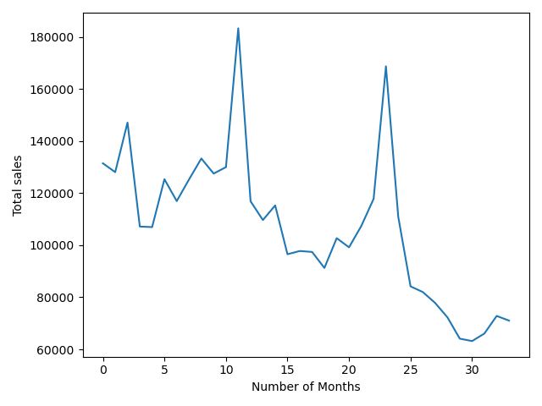
Sales vs Months

Slide 8
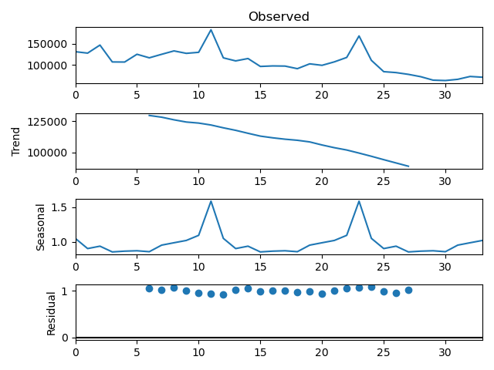
Seasonal Decomposition

Slide 9
Conclusion
Sales vs month plot shows that sales are decreasing over time
The second plot also shows a decreasing trend, also we observe that there is nothing like seasonality. In over 34 months span sales was good in only 2 seasons.
As per the kaggle submission scores we observe that for the given underlying dataset weighted moving average performs best since there is no seasonality present in the data

Slide 10
References
https://towardsdatascience.com/time-series-forecasting-using-auto-arima-in-python-bb83e49210cd
https://www.kaggle.com/jayantawasthi/rnn-used-to-predict-future-sale
https://www.kaggle.com/szhou42/predict-future-sales-top-11-solution
https://github.com/VipinindKumar/Predict-Future-Sales/blob/master/sales1(oct_as_pred).ipynb
https://github.com/krishnaik06/ARIMA-And-Seasonal-ARIMA/blob/master/Untitled.ipynb

Slide 11
THANK YOU

